Slide 1
第三章 立体及其交线
Chapter 3 Solids and Their Intersections
棱柱的投影Projection of Prism
棱锥的投影Projection of Pyramid
圆柱的投影Projection of Cylinder
圆锥的投影Projection of Cone
圆球的投影Projection of Sphere
平面与平面立体相交 Intersection of Plane and Polyhedral Solid(cutting)
平面与圆柱相交 Intersection of plane and Cylinder(cutting)
平面与圆锥相交 Intersection of plane and Cone(cutting)
平面与圆球相交 Intersection of plane and Sphere(cutting)
立体相交Intersection of slides

Slide 2
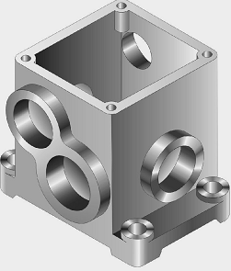
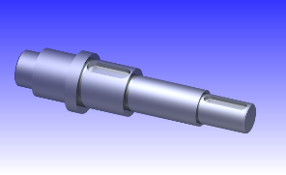
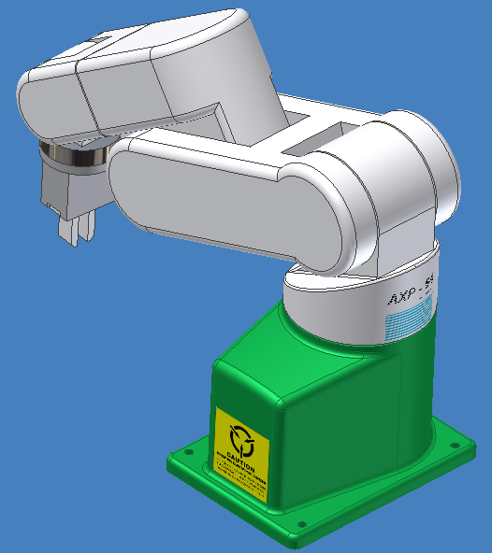
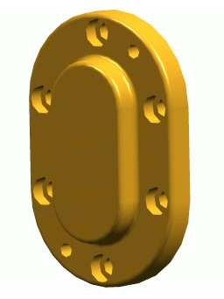
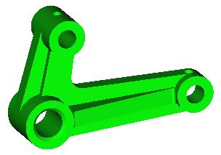
许多产品可看作由某些基本几何体及各种由它们相交而成的形体所组成。 Many products can be interpreted as consisting of some basic geometric solids and their intersecting variations.

Slide 3
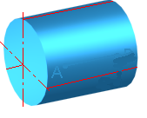
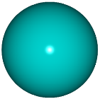

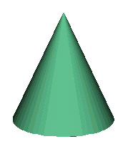

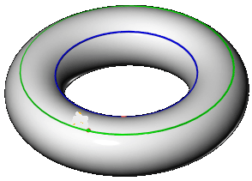
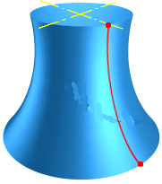
常见的基本几何体
Most widely used Primitive Solids
平面基本体
Plane Primitive Solids
曲面基本体
Surface Primitive Solids
圆柱 Cylinder
圆球 Sphere
圆锥 Cone
棱柱 Prism
棱锥 Pyramid
圆环 Torus
其他回转体 Revolved body

Slide 4
1. 棱柱Prism
正六棱柱
Right hexagonal prism
棱柱的组成Construct of Prism
由两个底面和几个侧棱面组成。侧棱面与侧棱面的交线叫侧棱线，侧棱线相互平行。 A prism has tow bases which are parallel equal polygons , and three or more lateral faces, which are parallelograms.
棱柱的三视图
在图示位置时，六棱柱的两底面为水平面，在俯视图中反映实形。前后两侧棱面是正平面，其余四个侧棱面是铅垂面，它们的水平投影都积聚成直线，与六边形的边重合。Prism be located as right figure. Both of its bases are horizontal planes and show their true shapes in the Top view. Both the front and back side are frontal planes and all the other four sides are H-perpendicular planes which concentrate to lines in the Top view.

Slide 5
棱柱面上取点Locate points on the face of prism
a′
a″
●
●
(b′)
b″
●
●
b
●
●
（B）
a
A
●
●

Slide 6
2. 棱锥Pyramid
棱锥的组成 Construct of Pyramid
由一个底面和几个侧棱面组成。侧棱线交于一点——锥顶。 A pyramid has a polygon for a base and triangular lateral faces intersecting at a common point called the Vertex
s′
s″
●
●
棱锥的三视图Three views of the pyramid
三棱锥处于图示位置时，其底面ABC是水平面，在俯视图上反映实形。侧棱面SAC为侧垂面，另两个侧棱面为一般位置平面。Triangular Pyramid be located as right figure. Its bottom is horizontal plane and shows true shape in the Top view. Side SAC is W-perpendicular plane and the other two sides are oblique planes.
a′
c′
a″(c″)
b″
a
c
s
●
b

Slide 7
棱锥面上取点Locate points on the face of pyramid
s′
s″
●
●
k′
k″
●
n′
●
n″
●
●
( )
K
a′
b′
c′
a″(c″)
b″
●
a
c
N
●
●
s
k
n
●
●
b

Slide 8

平面基本体 Plane Basic Solids
棱台
Frustum
( Truncated Pyramid )
棱柱 Prism
棱锥Pyramid
正棱柱 Right prism
斜棱柱 Oblique prism
正棱锥 Right pyramid
斜棱锥 Oblique pyramid
正四棱锥
Right square pyramid

Slide 9
消隐后效果 After hiding the invisible edges

Slide 10
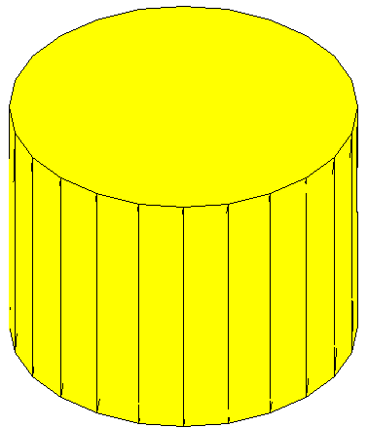
O
3. 圆柱体 Cylinder
A
⑴ 圆柱体的组成 the constructure of cylinder
圆柱体由圆柱面和两底面组成。
Cylinder includes two plane and cylindrical surface
O₁
A₁
圆柱面是由直线AA₁绕与它平行的轴线OO₁旋转而成。 Cylindrical surface is generated by a straight line (AA₁) that revolves about an axis OO₁ to which the line is parallel.
直线AA₁称为母线。
Line AA₁ is called generator (generatrix)
圆柱面上与轴线平行的任一直线称为圆柱面的素线。圆柱面可以看作是由无数条素线组成。
The various positions of he generator are called elements. Thus a cylindrical surface is considered to be composed of an infinite number of elements.

Slide 11
⑵ 圆柱体的三视图 Three views of cylinder
圆柱面的俯视图积聚成一个圆，在另两个视图上分别以两个方向的轮廓素线的投影表示。轮廓素线的投影称为外形线。
The top view of cylindrical surface appears as a circle , while it is represented by the projections of contour elements on the other two views .
⑶轮廓素线的投影与曲面的可见性的判断
The projections of contour elements and the visibility of the surface
a′
a″
●
●
利用投影的积聚性
By the concentrating projection
⑷ 圆柱面上取点
Locate point on the cylindrical surface
●
a

Slide 12
4. 圆锥体 Cone
S
O
(1) 圆锥体的组成The structure of cylinder
由圆锥面和底面组成。
Cone includes one bottom plane and conical surface
A
O₁
圆锥面是由直线SA绕与它相交的轴线OO₁旋转而成。
Conical surface is generated by a straight line (SA) that revolves about an axis OO₁ with which the line intersects at point S.
S称为锥顶，直线SA称为母线。圆锥面上过锥顶的任一直线称为圆锥面的素线。
S is called the vertex and line SA is the generator. Any straight lines through the vertex on conical surface are called elements.

Slide 13
⑵ 圆锥体的三视图Three views of cone
S
在图示位置，俯视图为一圆。另两个视图为等腰三角形，三角形的底边为圆锥底面的投影，两腰分别为圆锥面不同方向的两条轮廓素线的投影(外形线)。
The top view of conical surface appears as a circle while both of the other two views are isoceles triangles which their side edges are the projections of contour elements of the cone.
●
s′
s″
●
●
s

Slide 14

S
圆锥面上取点
Locate points on the cylindrical surface
★辅助直线法 Auxiliary line method
●
★辅助圆法 Auxiliary circle method
s′
s″
●
●
k′
●
(n″)
●
(n′)
●
●
k″
n
如何在圆锥面上画线？How to construct line on the conical surface.
●
s
●
通过锥顶的素线An element through the vertex.
k
半径Radius?

Slide 15
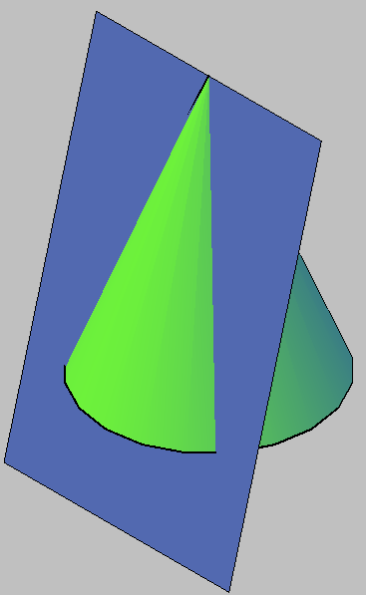
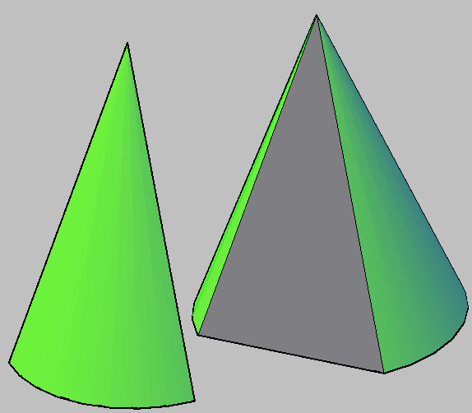

Slide 16
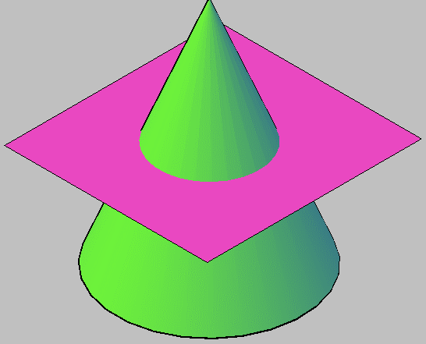
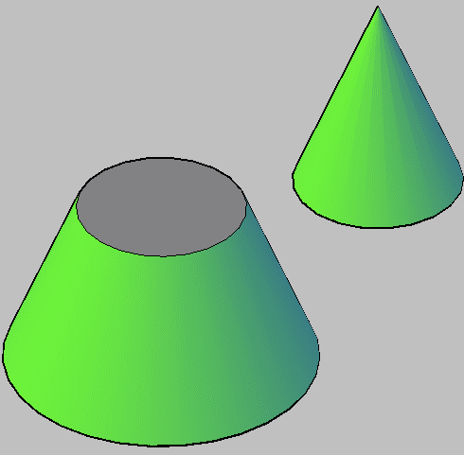

Slide 17
5. 圆球Sphere
⑴ 圆球的形成 The generation of sphere
圆母线以它的直径为轴旋转而成。Sphere is generated by revolving a circular generator with its diameter as axis.
⑵ 圆球的三视图
三个视图分别为三个和圆球的直径相等的圆，它们分别是圆球三个方向轮廓线的投影。
Three views are all circles with the same diameter as the sphere which are the projections of the contour elements of the sphere .

Slide 18
（3）圆球面上取点
Locate points on the spherical surface
辅助圆法
Auxiliary circle method
●
●
k′
k″
(m′)
●
●
(m′′)
●
半径Radius?
(m)
k
●

Slide 19
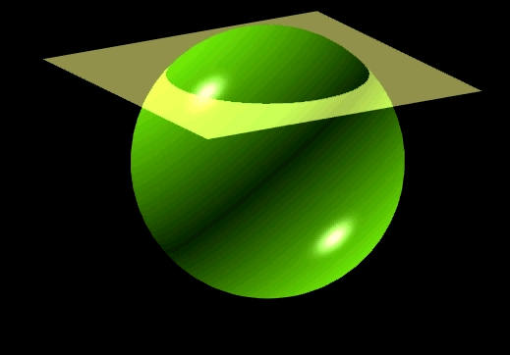
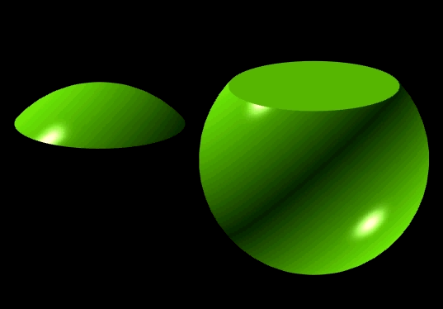

Slide 20

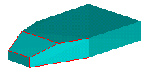

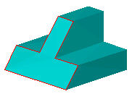
6.平面与平面立体相交 Intersection of Plane and Polyhedral Solid
（切割型平面立体 Cut-like Plane Solid）

Slide 21
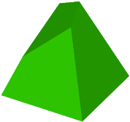
例1：求四棱锥被截切后的俯视图和左视图。
Complete the top view and left view of the truncated square pyramid.
4
●
1
●
1′
1″
●
(4′)
4″
●
2″
3
2
2′
●
●
●
3′
3″
●
★ 空间分析Spatial analysis
4
★ 投影分析Projection analysis
●
交线的形状？Shape of the section?
3
1
★ 求截交线 Find the lines of section
●
●
2
★ 分析棱线的投影 Edges
●
★ 检查Check 尤其注意检查截
平面投影的亲似性 Notice the similarity of the projections of section

Slide 22
例1：求四棱锥被截切后的俯视图和左视图。

Slide 23
例2：求四棱锥被截切后的俯视图和左视图。
Ex2：Complete the top view and left view of the truncated square pyramid.
●
●
1′(2′)
2″
1″
2
1

Slide 24
例2：求四棱锥被截切后的俯视图和左视图。
Ex2：Complete the top view and left view of the truncated square pyramid.

Slide 25
例 3: 求八棱柱被平面P截切后的俯视图。
Complete the top view of the eight-square prism cut by plane P.
P′
4′≡5′
5″
4″
7″
6″
3″
2″
2′≡3′≡6′≡7′
1′≡8′
8″
1″
8
7
5
6
Ⅴ
Ⅳ
Ⅶ
3
Ⅵ
4
Ⅲ
Ⅷ
Ⅱ
1
2
Ⅰ

Slide 26
例 3: 求八棱柱被平面P截切后的俯视图。
Complete the top view of the eight-square prism cut by plane P.

Slide 27
作业
P12
P13(1,2,3),
P14(1,3，4)
要求保留作图辅助线（很浅很细的线）
参考Refer to ：Textbook P31-46

Slide 28
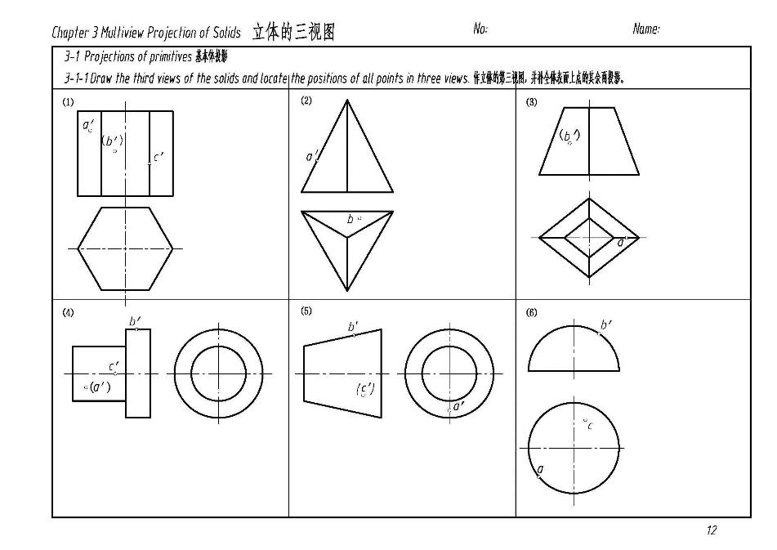
Homework： P12 Refer to ：Textbook P31-46

Slide 29
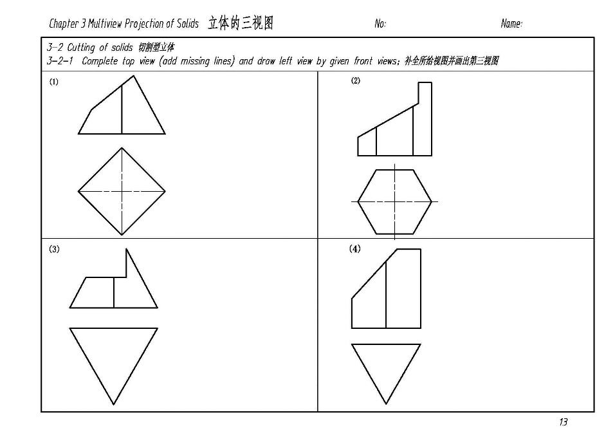
Homework P13

Slide 30
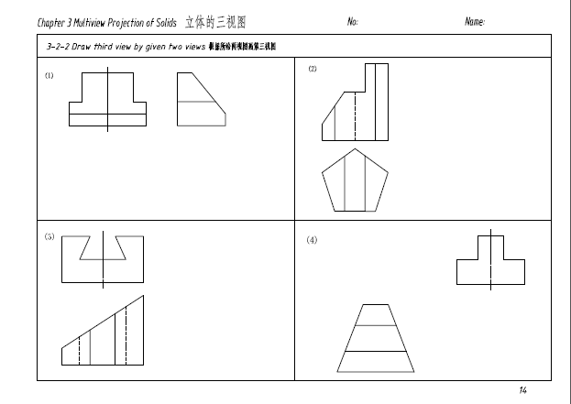
Homework1 P14

Slide 31

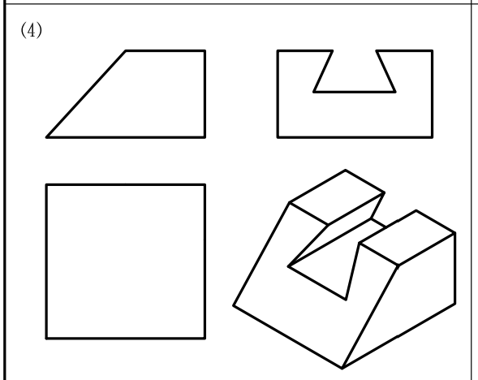
课堂练习：P11-（4）
完成后拍照上传到指定链接 https://bhpan.buaa.edu.cn:443/link/3CF915BDC27B835615766D5AFEF59B2A 有效期限：2021-10-09 23:59

